Slide 1
Student Name
Vigneshwaran H
cse-III year
NM_ID : au421221104056
KVCET
Final Project

Slide 2
PROJECT TITLE
Denoising images with Generative Adversarial Network (GAN).

Slide 3


AGENDA
Introduction
Problem statement
Project overview
Who are the end users
Solution and its value proposition
The wow in solution
Modeling
Result
3/21/2024 Annual Review

Slide 4

PROBLEM STATEMENT
This project Aims to Develop a Generative Adversarial Network (GAN) to Remove unwanted noises and blurry things present in the image.
The Objective of this project is to create enhanced images from noisy images.

Slide 5

PROJECT OVERVIEW
This Project aims to revolutionize image enhancement through the innovative application of Generative Adversarial Networks (GANs) to denoise images. Noise is a common problem in images captured under challenging conditions, such as low light or high ISO settings, which can degrade image quality and affect various applications like medical imaging, surveillance, photography, and more.
3/21/2024 Annual Review

Slide 6

WHO ARE THE END USERS?
Any individual user who wants denoisify their images.
Organizations and enterprises who wants to use image denoising as their business.
3/21/2024 Annual Review

Slide 7

OUR SOLUTION AND ITS VALUE PROPOSITION
solution :
It Leverages state-of-the-art Generative Adversarial Networks (GANs) to address the common challenge of noisy images by providing an innovative denoising approach. Unlike traditional methods that often result in loss of image quality or require extensive manual intervention
Value proposition:
Our denoising solution offers unparalleled advantages in image restoration and enhancement.
3/21/2024 Annual Review

Slide 8

THE WOW IN OUR SOLUTION
Project harnesses the power of cutting-edge Generative Adversarial Networks (GANs) to transform noisy, grainy images into stunningly clear and vibrant visuals.
Revolutionize the way noise is eliminated from images, unlocking new possibilities for high-fidelity visual content across industries ranging from medical imaging to surveillance, photography, and beyond.
3/21/2024 Annual Review

Slide 9
MODELLING
The generator aims to minimize the perceptual difference between its denoised outputs and the corresponding clean images, while the discriminator endeavors to accurately classify real and fake images.
Throughout training, the GAN's components engage in an adversarial interplay, where the generator aims to produce increasingly realistic denoised images, while the discriminator strives to differentiate between real and generated images.
This iterative process continues until convergence. Evaluation on a separate validation dataset is crucial to assess the GAN's performance in denoising unseen images.

Slide 10
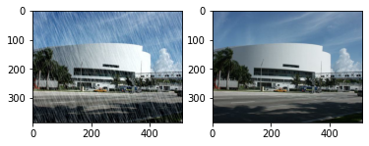
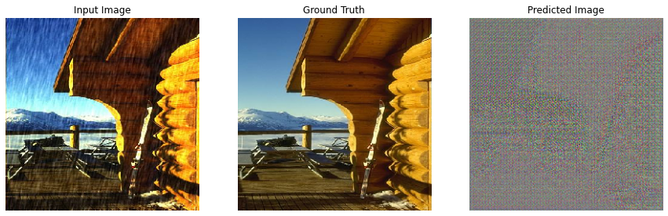
RESULTS
Sample: Input Output
Input Output

